Slide 1
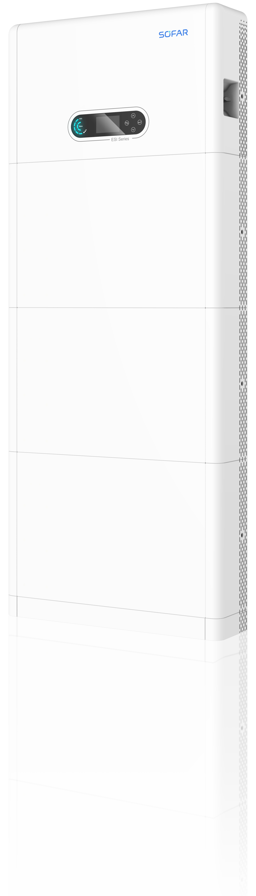
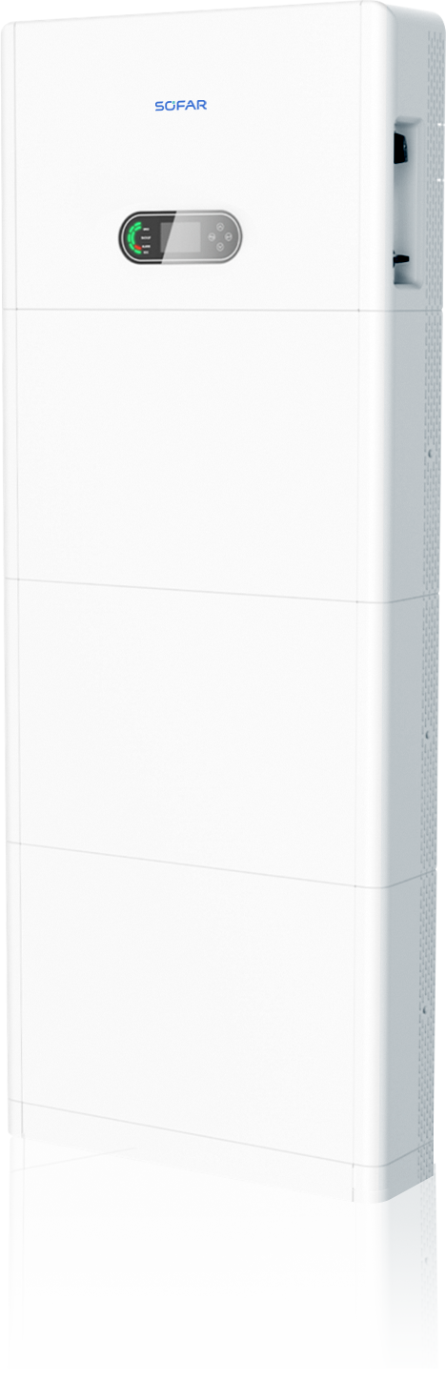


SOFAR PowerAll
Single-Phase All-In-One ESS
SOFAR

Slide 2

Storage Market Europe
Source: SolarPower Europe (2024): European Market Outlook for Battery Storage 2024-2028

Slide 3

SOFAR ESS Success
2.8 GWh
SOFAR storage systems installed
330,000+
Battery modules sold

Slide 4


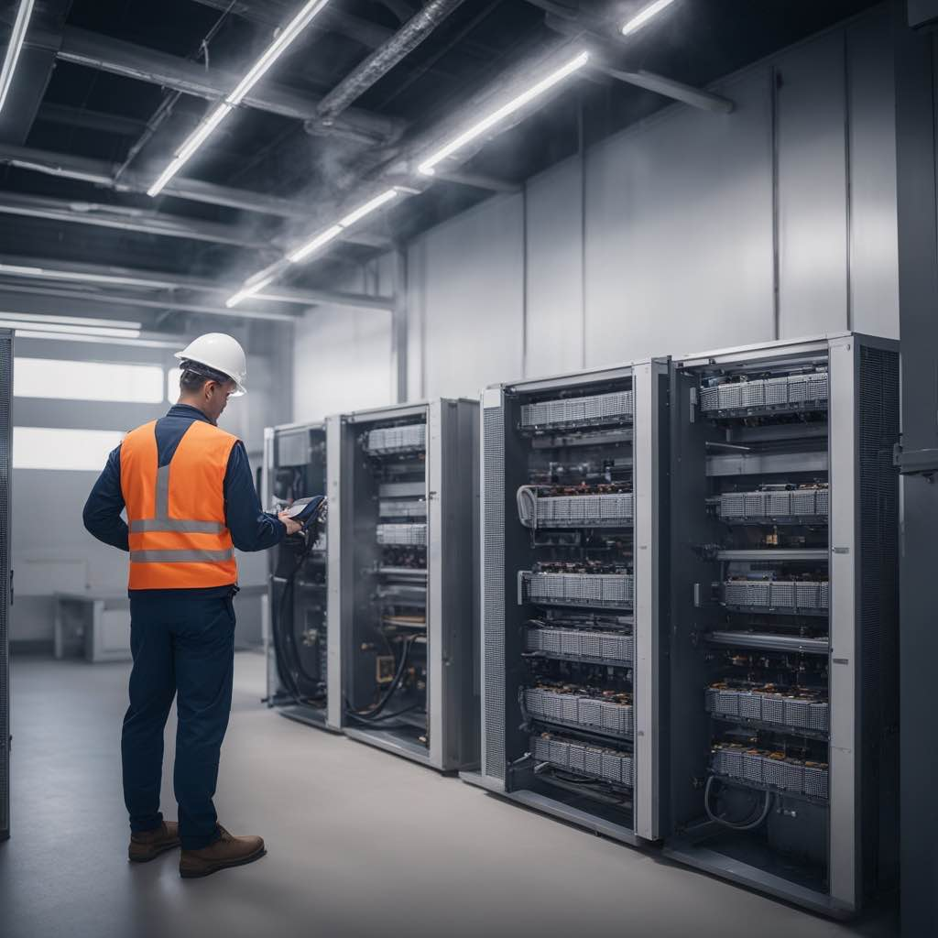
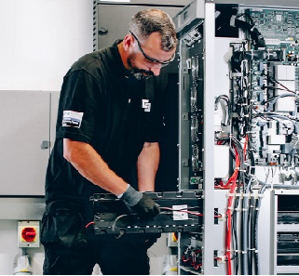
ESS Challenges
Design
Logistics
Installation
Maintenance
Minimum voltage and capacity
Inflexible scaling
Different models of products in stock
Routine battery recharge
Cable preparation
Complicated setup-procedures
Battery calibration charging
Limited expansion
Limited upgrade ability
SOH variation

Slide 5
ESI 3-6K-S1
ESI-8-12K-S1

Slide 6



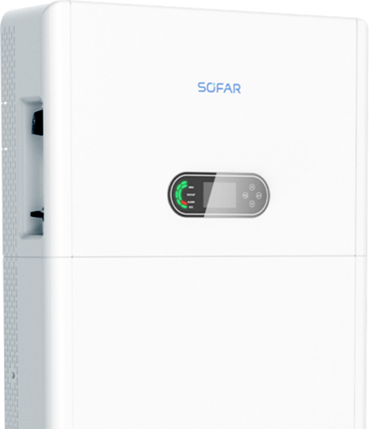


Features
Simplicity
Flexibility
Safety
Smartness

Slide 7

Simplicity

Slide 8
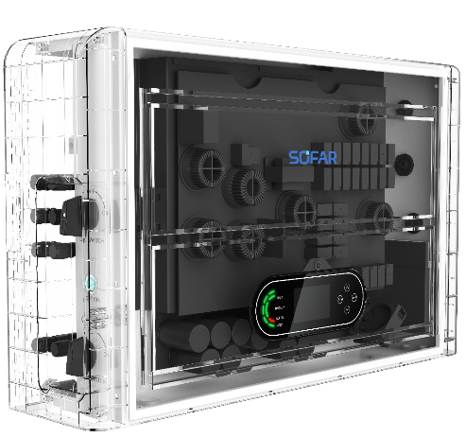
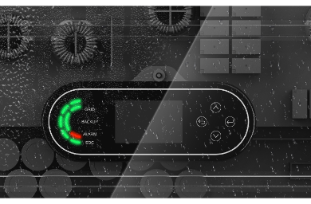

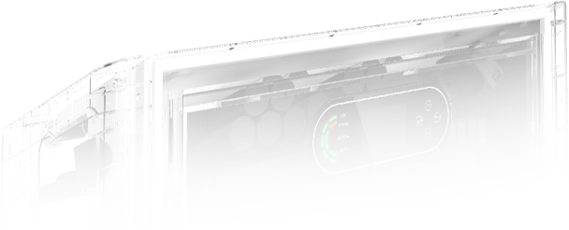

User-friendly
01
LCD PANEL 240*160 Dots
03
IP65+ Touch Button
Operation data at a glance
Smooth operation in rainy days
02
Runway Status Lights
04
Natural Cooling Design
Clear system status
Optimal sleep with noise levels below 30dB at night

Slide 9

Modular Design
Convenient to Transport and Install

Slide 10
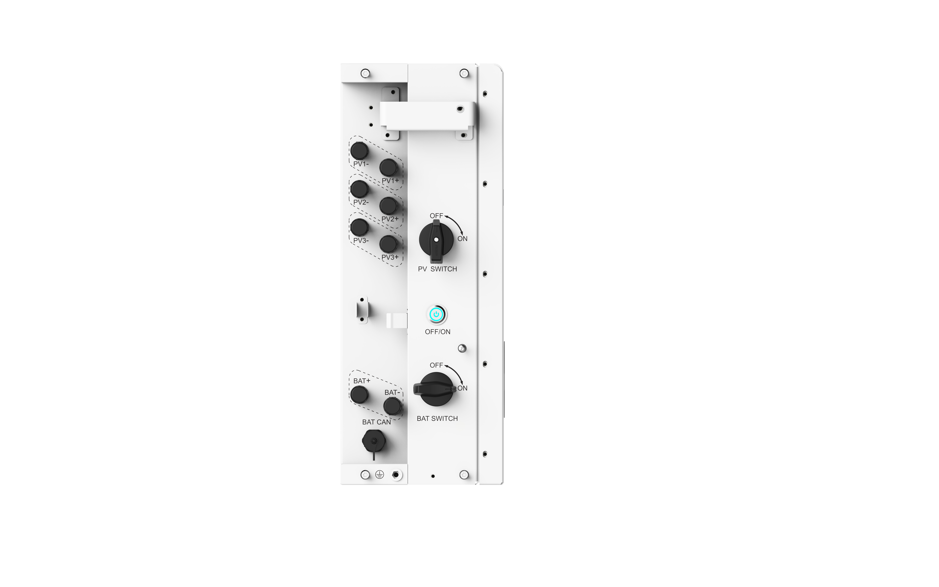
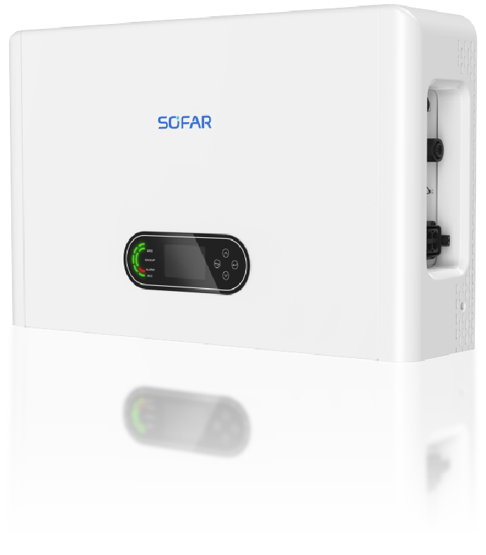
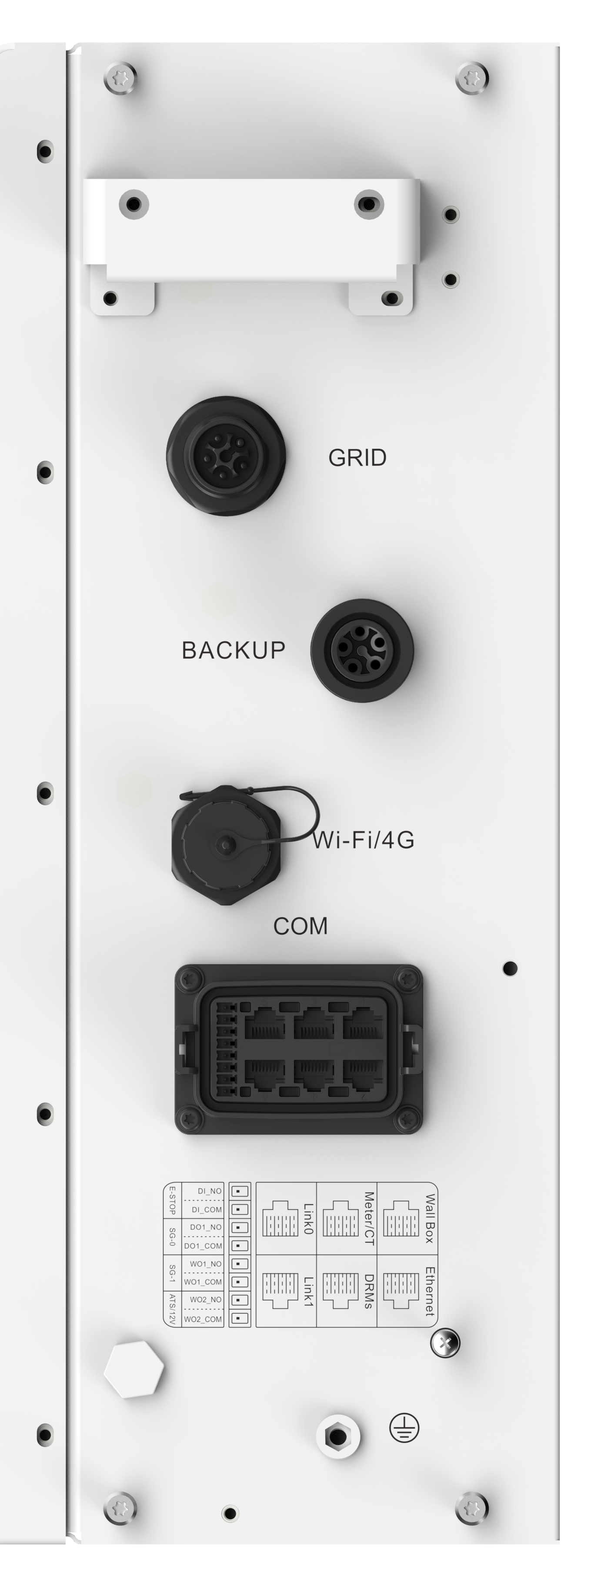
User-friendly ESI series
Grid Input
PV Input
EPS Output
PV Switch
Battery power button
Wi-Fi/4G
BAT Input
BAT Switch
COM Port
BAT Communication port

Slide 11
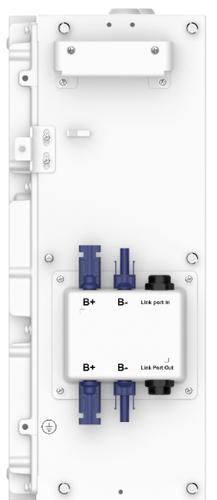
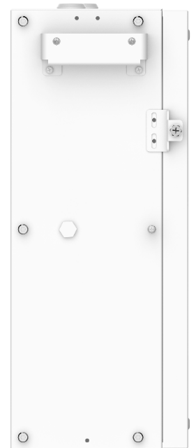


User-friendly BTS 5K
BAT Output
to Inverter
BAT Input
for Parallel battery

Slide 12
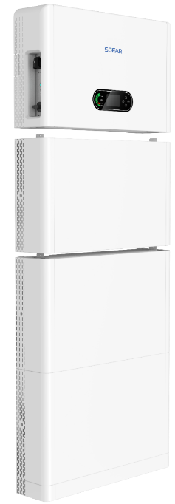

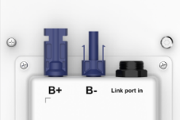


Easy Installation
Small and light
Quick Connectors
Inverter: 35kg, Battery: 50kg - easy to carry for 2 people
Tool-unlocked connectors for plug-and-play installation
Pre-assembled Cables
One Click Initialization
Prefabricated power and communication cables to shorten installation time
LCD screen and app provide simple boot-up guidance for quick start

Slide 13
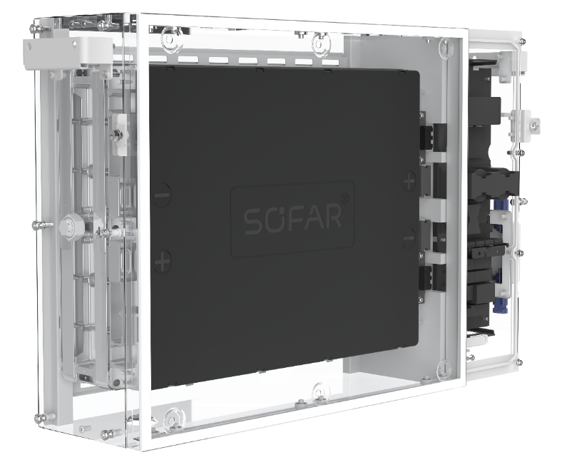

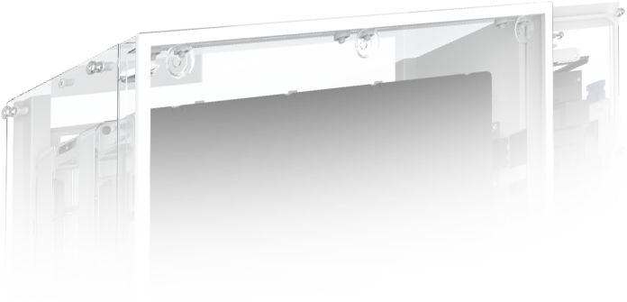
SOC Automatic Calibration
Smart Correction Strategy
Battery initialization automatically calibrates SOC with remote maintenance support, no need for on-site chargers
High Efficiency Battery Optimizer
Monthly SOC full charge calibration with single power consumption not exceeding 0.1kWh

Slide 14

Ultra-Low Self-Consumption
Hibernation Mode < 5mW
No recharging needed for 24 months, reducing warehousing and electricity
replenishment costs
System Sleep Mode loss < 10W
Consumes 10W of power at night (including data logger with 24-hour monitoring),
typical power consumption for 8 hours at night is 0.08kWh

Slide 15

Safety

Slide 16
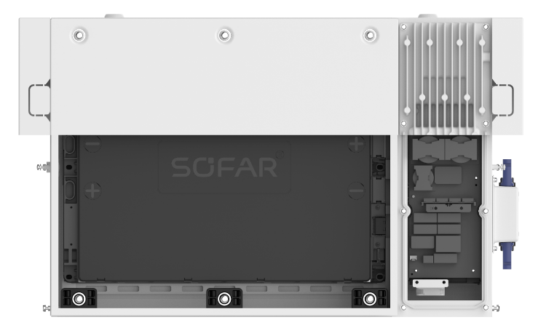


Battery and Electricity Separation
01
Safer for Personnel and Equipment
02
Support Battery Heating Function
10-year standard warranty and high-value property insurance provided
Wider operating temperature range, more reliable for outdoor installation
Battery
Electricity

Slide 17


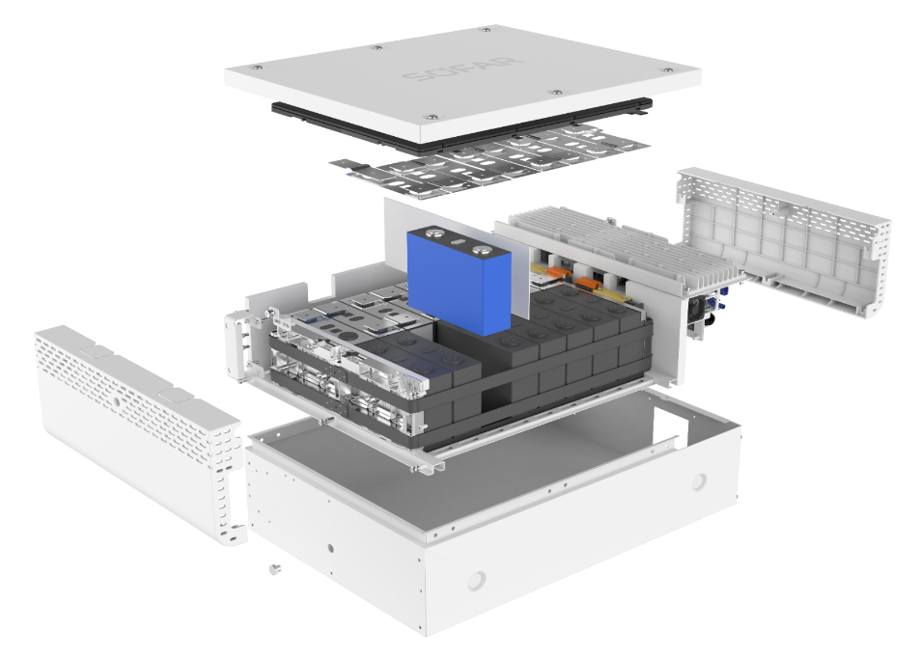

Ultimate Safety Design
5-stage Multilevel Protection
Redundancy sensor architecture
Cell and module level protection combination eliminates thermal runaway risk
100% coverage of battery cell temperature detection proactively identifies sensor faults, reducing false alarms and downtime
HiRes-Temperature Sensors
Aerogel Pads
High-Performance Insulation Pads
LiFePO₄ Cells
Expansion Force Enhancement
M16 over-pressure valves

Slide 18
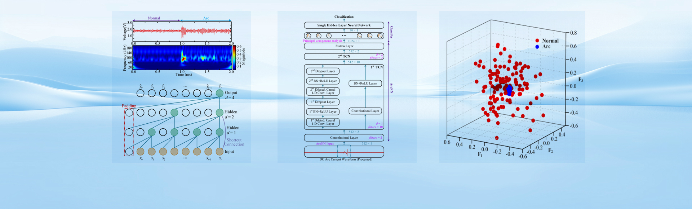
AFCI Detection for PV Strings
(ESI-8-12K-S1 support)
TCN fast fault detection
99.88% accuracy in 4981 samples, Supports offline learning and remote update
Typical action time 150ms, lower than standard 500ms, reducing fire risk
Combining offline learning with remote update for zero failure rate

Slide 19

Flexibility

Slide 20
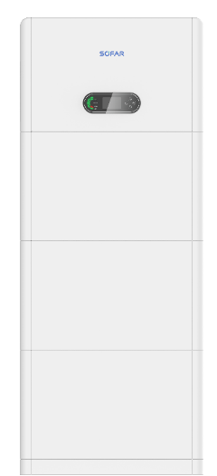

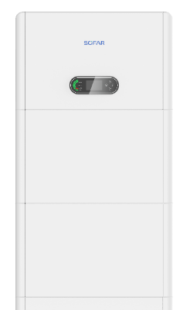


Flexible Expansion
Up to 6 Subsystems: 3 kW … 72 kW
Power
12 kW/30 kWh
3 kW/5 kWh
......
Capacity
Up to 6 Batteries: 5 kWh … 30 kWh per Subsystem

Slide 21
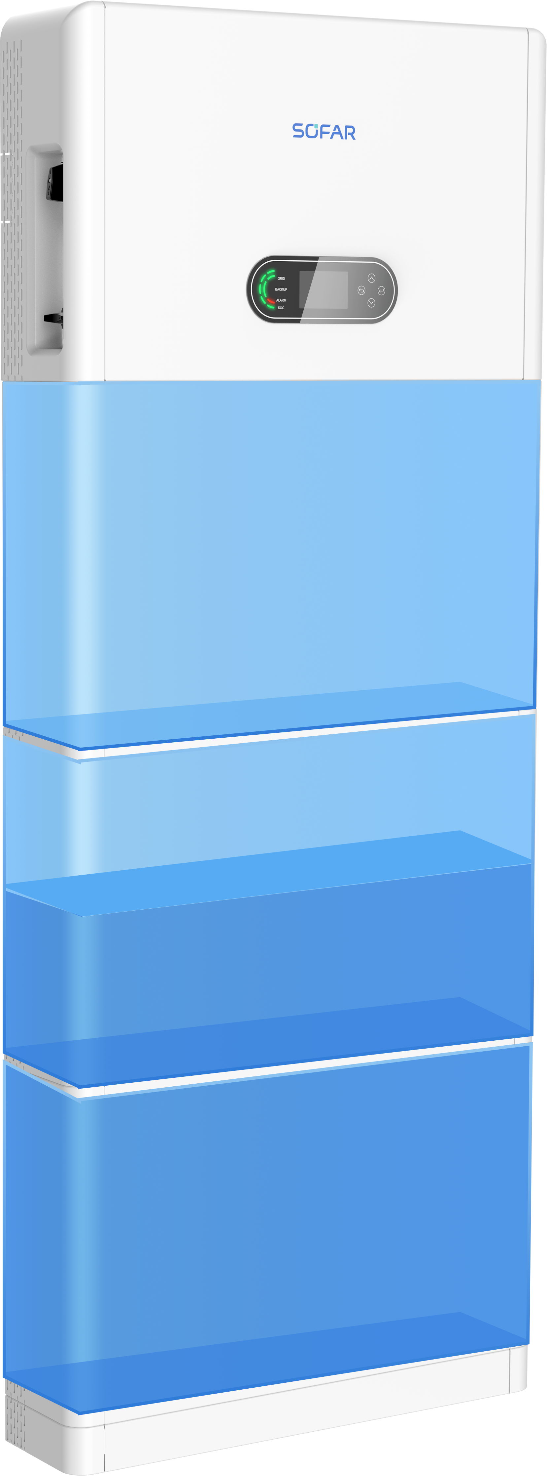
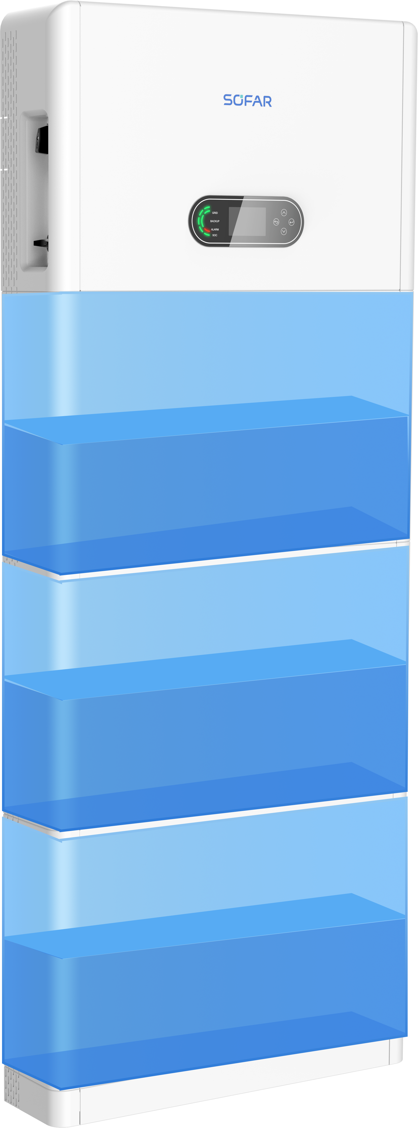

Active Equalization
Full Power Fast Active Battery Balancing
0%
50%
Automatically balances SOC deviation within 2 hours for faster installation
Discharging
Discharging
24 Hours Balancing Error Less than 5%
50%
50%
Ensures battery pack SOC difference within a day does not exceed 5%
Discharging
Discharging
Support Mixed Use of Different SOH and SOC
100%
50%
Allows mixed use of batteries from different batches and new/old batteries when expanding the system
Discharging
Discharging

Slide 22


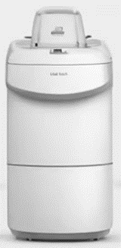

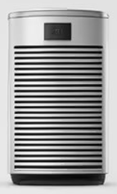
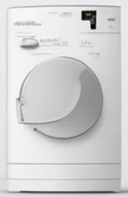

Integrated Auto-Switch for EPS
Immediate On-/Off-grid switchover
2 Times Surge Current for Device Start-up

Slide 23

Smartness

Slide 24
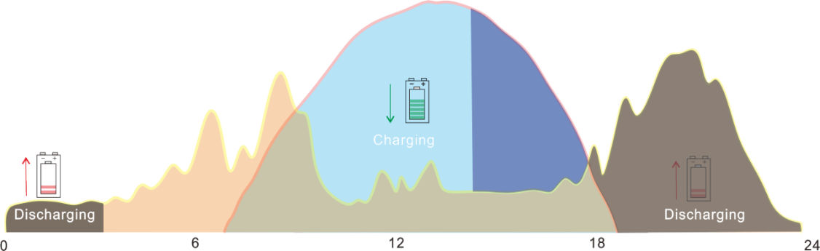
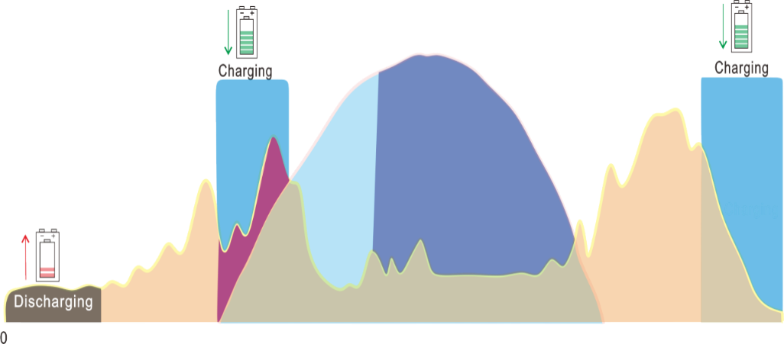
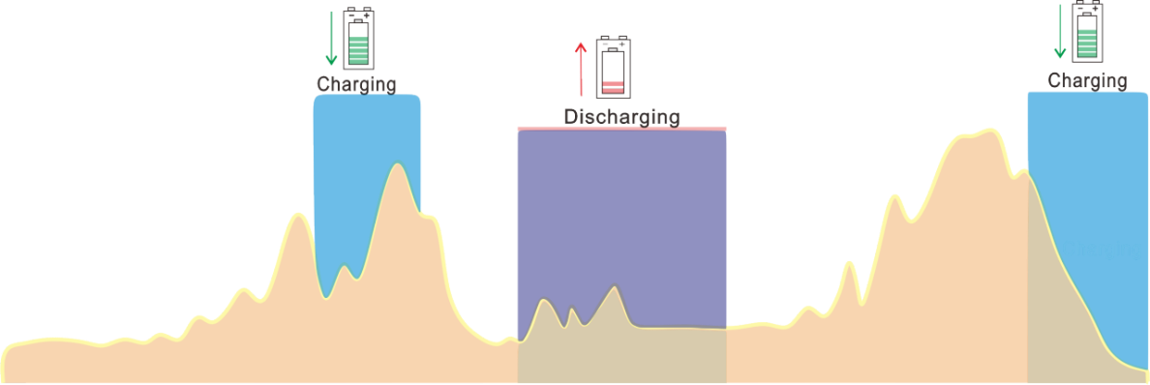
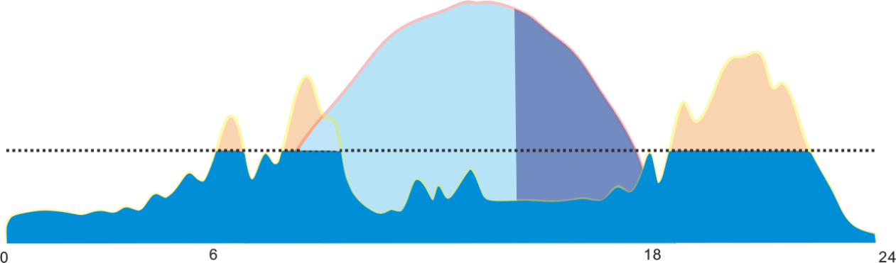
Multi-function Intelligent EMS
Self-Use, TOU, Timing, Peak-Shaving……
Compatible with AC EV charging management
According to local user needs
Built-in local EMS supports AC EV charger, no additional gateways required for solar energy car charging
Self-use
Time of Use
PV Power
PV Power
Load Consumption
Load Consumption
Timing
Peak-Shaving
ESS→Load
Grid Power Limit
Redundancy
PV→Grid

Slide 25


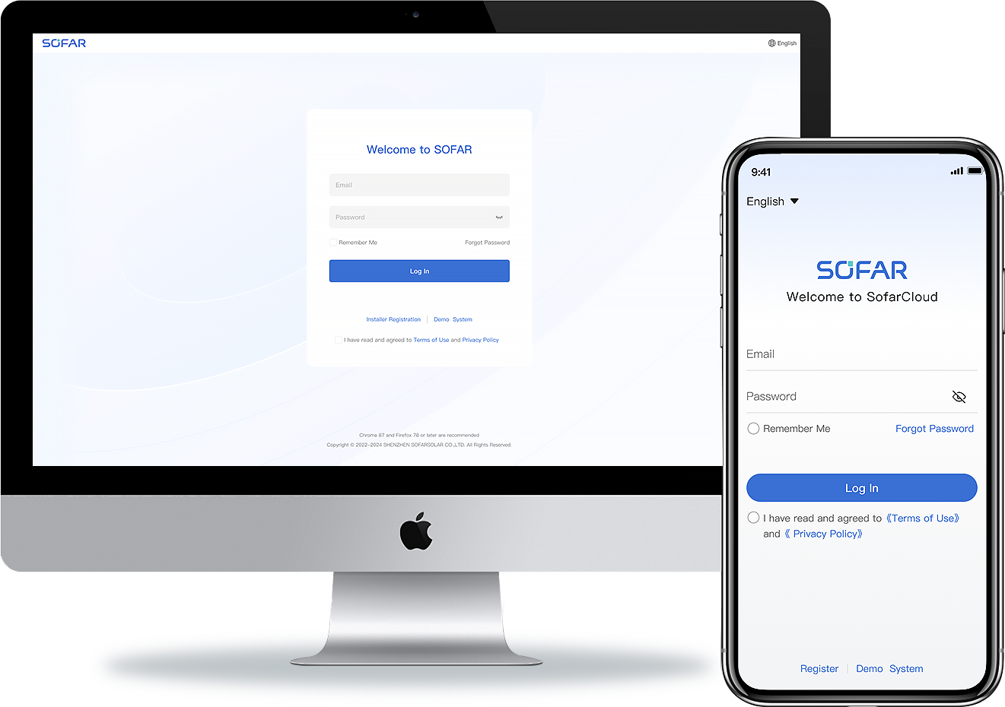







Real-Time Monitoring
Minimum 100 ms Data Update
24 Hours Consumption Monitoring
3 sec. Fast Power Response
Protocol supports quick power query with 100 ms interval for efficient VPP operation
Monitor household electricity consumption day and night for improved system efficiency
Support active/reactive power control and battery charging/discharging control commands for FFR and FCR requirements
24h
100 ms
3 sec.
Real-Time Data Refresh
Uninterrupted Load Monitoring
Fast Power Flow Switching

Slide 26
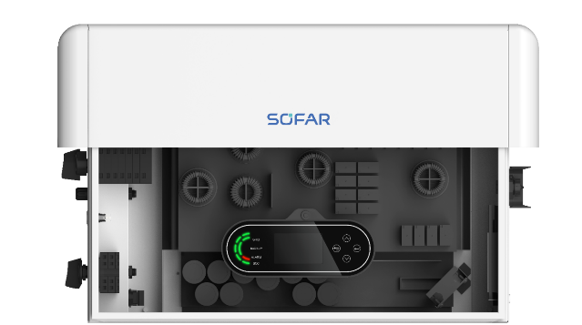
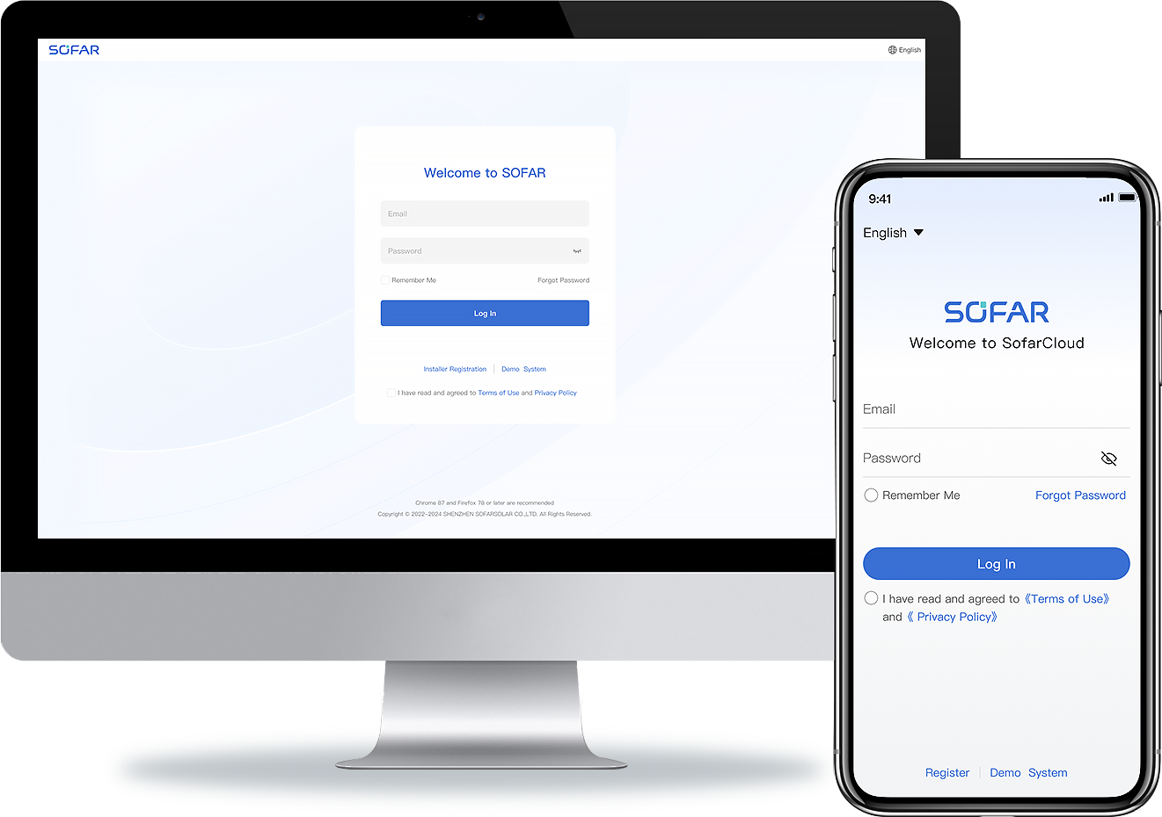
Cloud connected
Fast Remote Command Response
Remote Firmware Upgrade
Avoid on-site maintenance and reduce
maintenance costs
More accurate and higher success rate remote upgrade progress for improved user experience

Slide 27
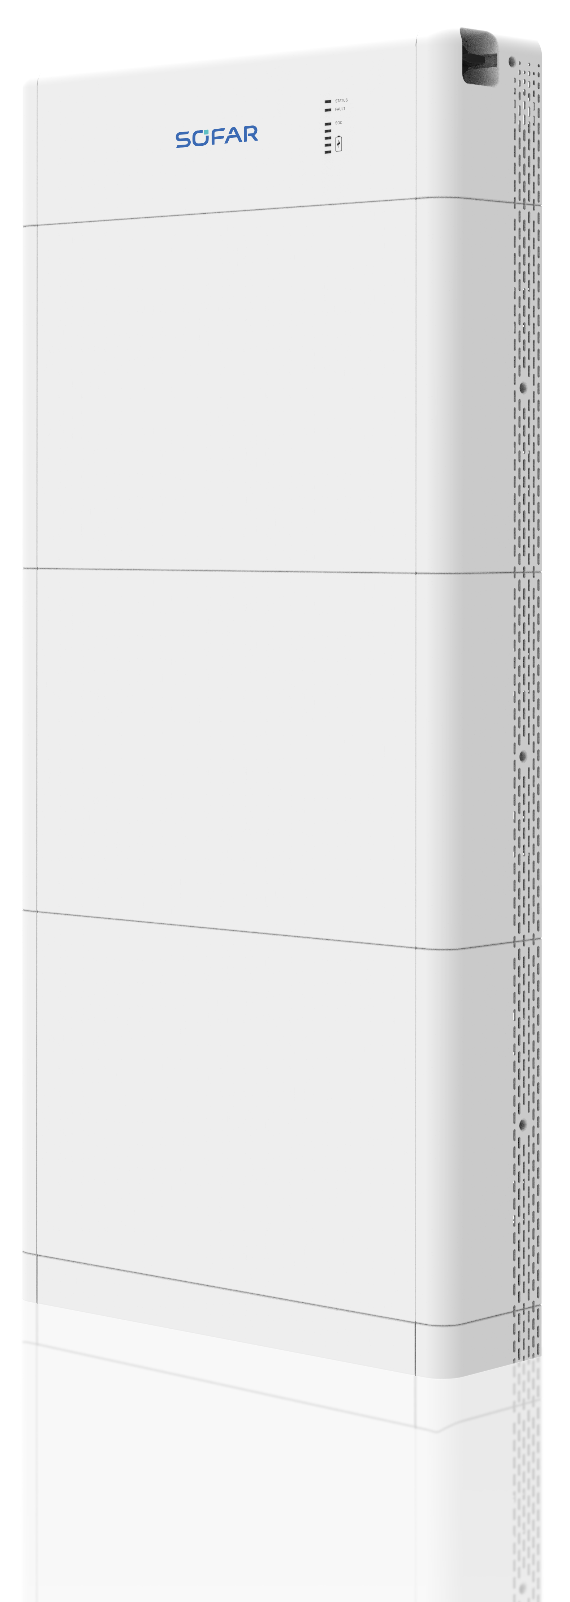
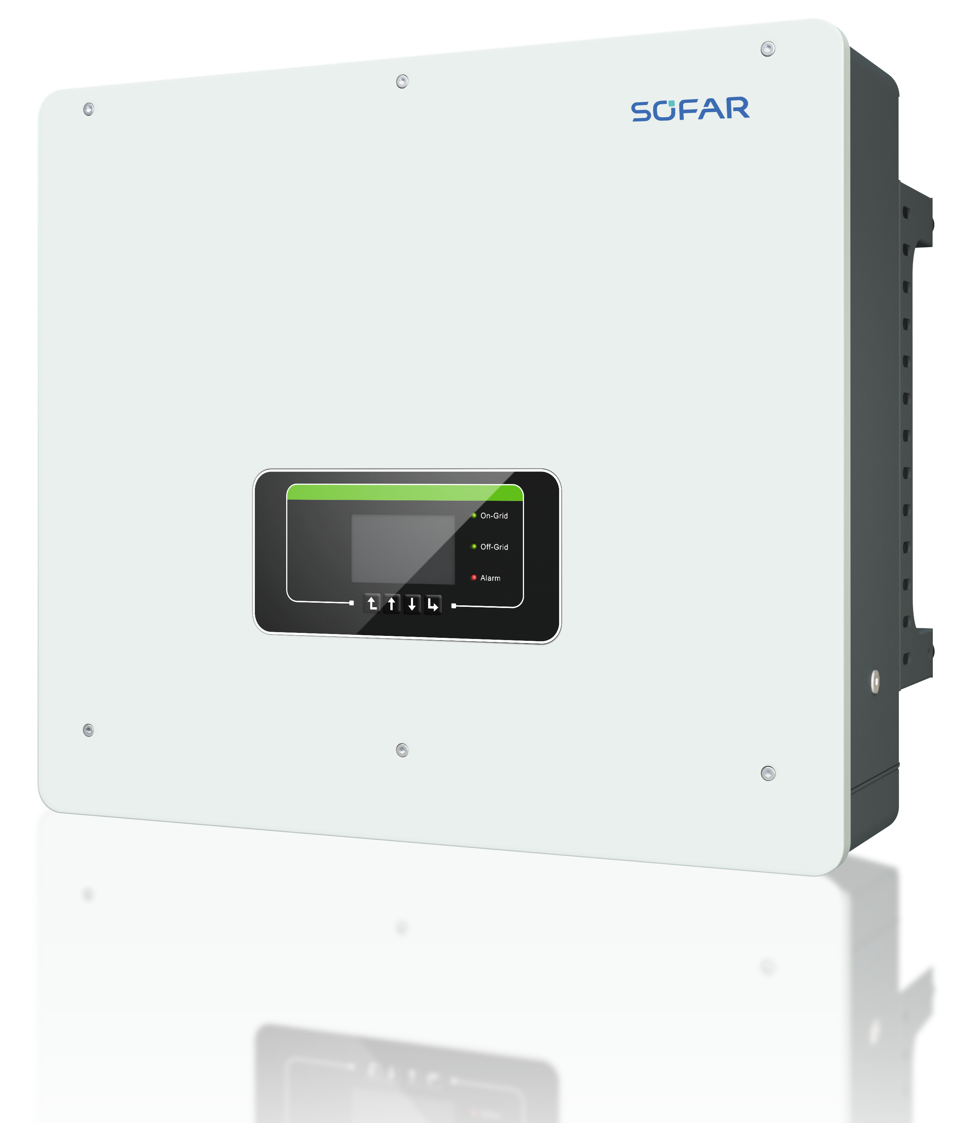
SOFAR Residential ESS family completed
PowerAll 1-phase
（3-6kW/8-12KW）
PowerAll 3-phase
（5-12KW）
HYD 5-20KTL-3PH + BTS E5-20-DS5

Slide 28


ENERGY TO
POWER YOUR LIFE
Website
www.sofarsolar.eu / .com
Email
europe@sofarsolar.com
Address
SOFARSOLAR GmbH
Krämerstr. 20, 72764 Reutlingen
Shenzhen SOFARSOLAR Co., Ltd.
11th Floor, Gaoxinqi Technology Building, District 67, Xingdong Community,
Xin'an Street, Bao'an District, Shenzhen, China

